Slide 1
forest fire detection
BY:-
Vivek kumar(ue155114)
Prashant kumar jha(ue155084)
Tarun teji(ue155107)

Slide 2
TABLE OF CONTENTS:-
INTRODUCTION
COMPONENTS USED
TECHNIQUE USED
EXPLANATION OF MODULES
SUMMARY
SCOPE OF IMPROVEMENTS

Slide 3
Introduction:-
Based on the principle of flame sensor.
Will detect the fire in the forest at initial stage.
Casualties will be less.
One time investment.
Multi-sensors to single station.

Slide 4
Components used:-
Arduino Uno
Gas and flame sensors with triggering
Battery Connectors
Red Led
Buzzer
LCD 16x2
RF module 434Mhz
Connector Wires
Resistor
Solar Panel :-12v
Rechargable Batteries 9V
Battery charger
Voltage regulator 9V
PCBs(5X4 & 6X5)

Slide 5
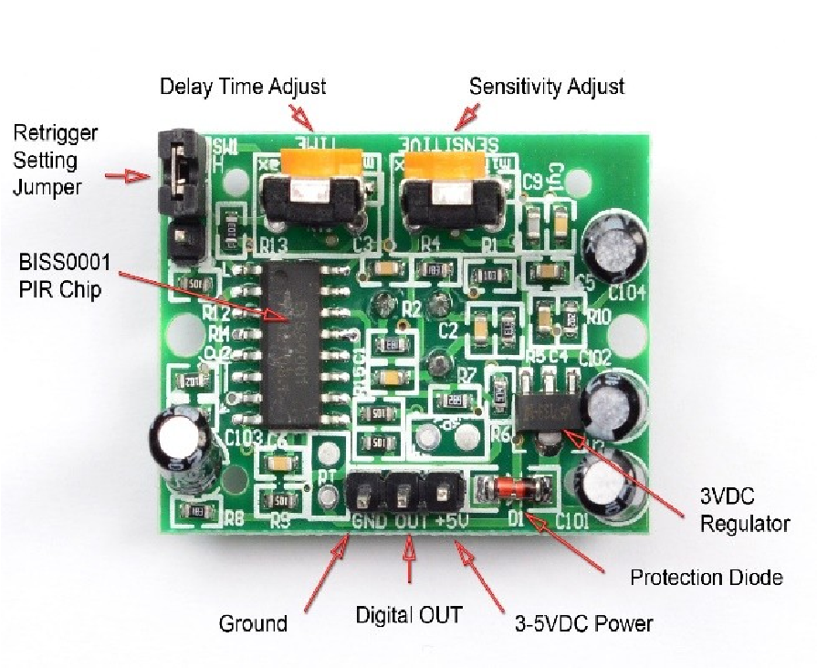
TECHNIQUE USED:-
Frequency modulation so as to have noise prone reception.
Microcontroller is used for the controlling input and output as per use.
flame sensors are used for fire detection.
fig:- PIR sensor

Slide 6
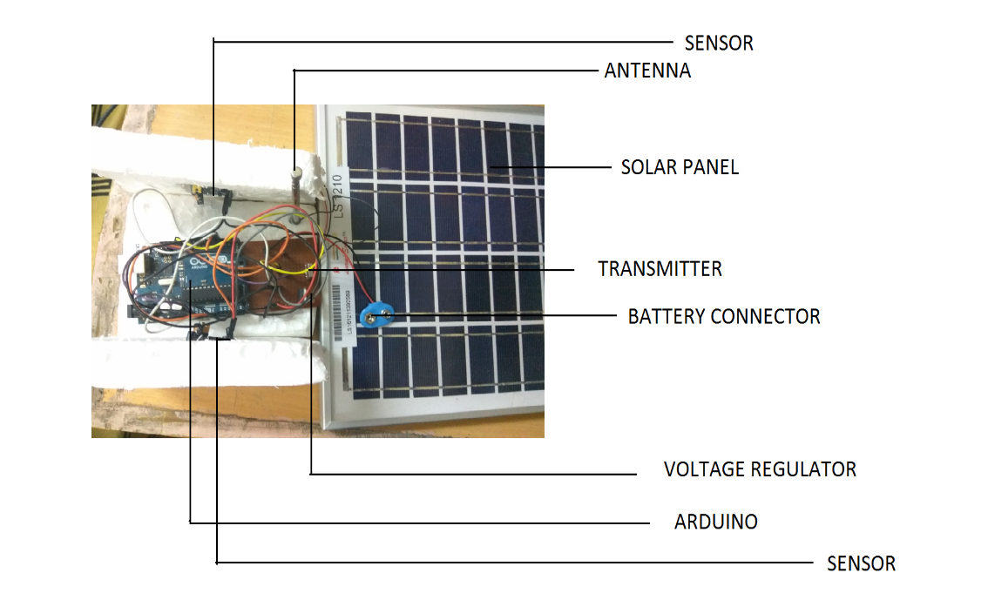
Transmitter:-
Parts of transmitter circuit:
flame sensors.
Transmitter.
Antenna.
Micro-controller(Arduino Uno).
Voltage regulator(7809).
Solar panel.

Slide 7
Working of transmitter:-
Firstly sensor will sense fire.
Next, output of the sensor is given to micro-controller.
Micro-controller programs according to the program and gives output.
Then the data is sent to the transmitter(434MHz).
Transmitter transmits the data to the receiver via antenna.

Slide 8
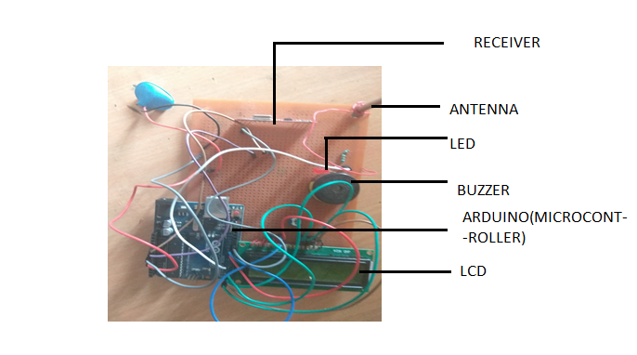
Receiver:-
Components of receiver part:
Buzzer.
Led.
Antenna.
Receiver.
Micro-controller(Arduino-UNO).
Lcd

Slide 9
Working of receiver:-
Receiver will receives the data via antenna.
Received data is sent to the micro-controller .
Micro-controller programs according to the data and gives the output.
As per output the data will be shown on the LCD display and buzzer will be blown if there is fire.
Also led will glow. Different LEDs are used for different transmitters,to
to know the exact transmitter.

Slide 10
Improvements:-
Multipurpous use for controlling fire in any large area.
Improving the range of device.
Increasing no. of transmitters.

Slide 11
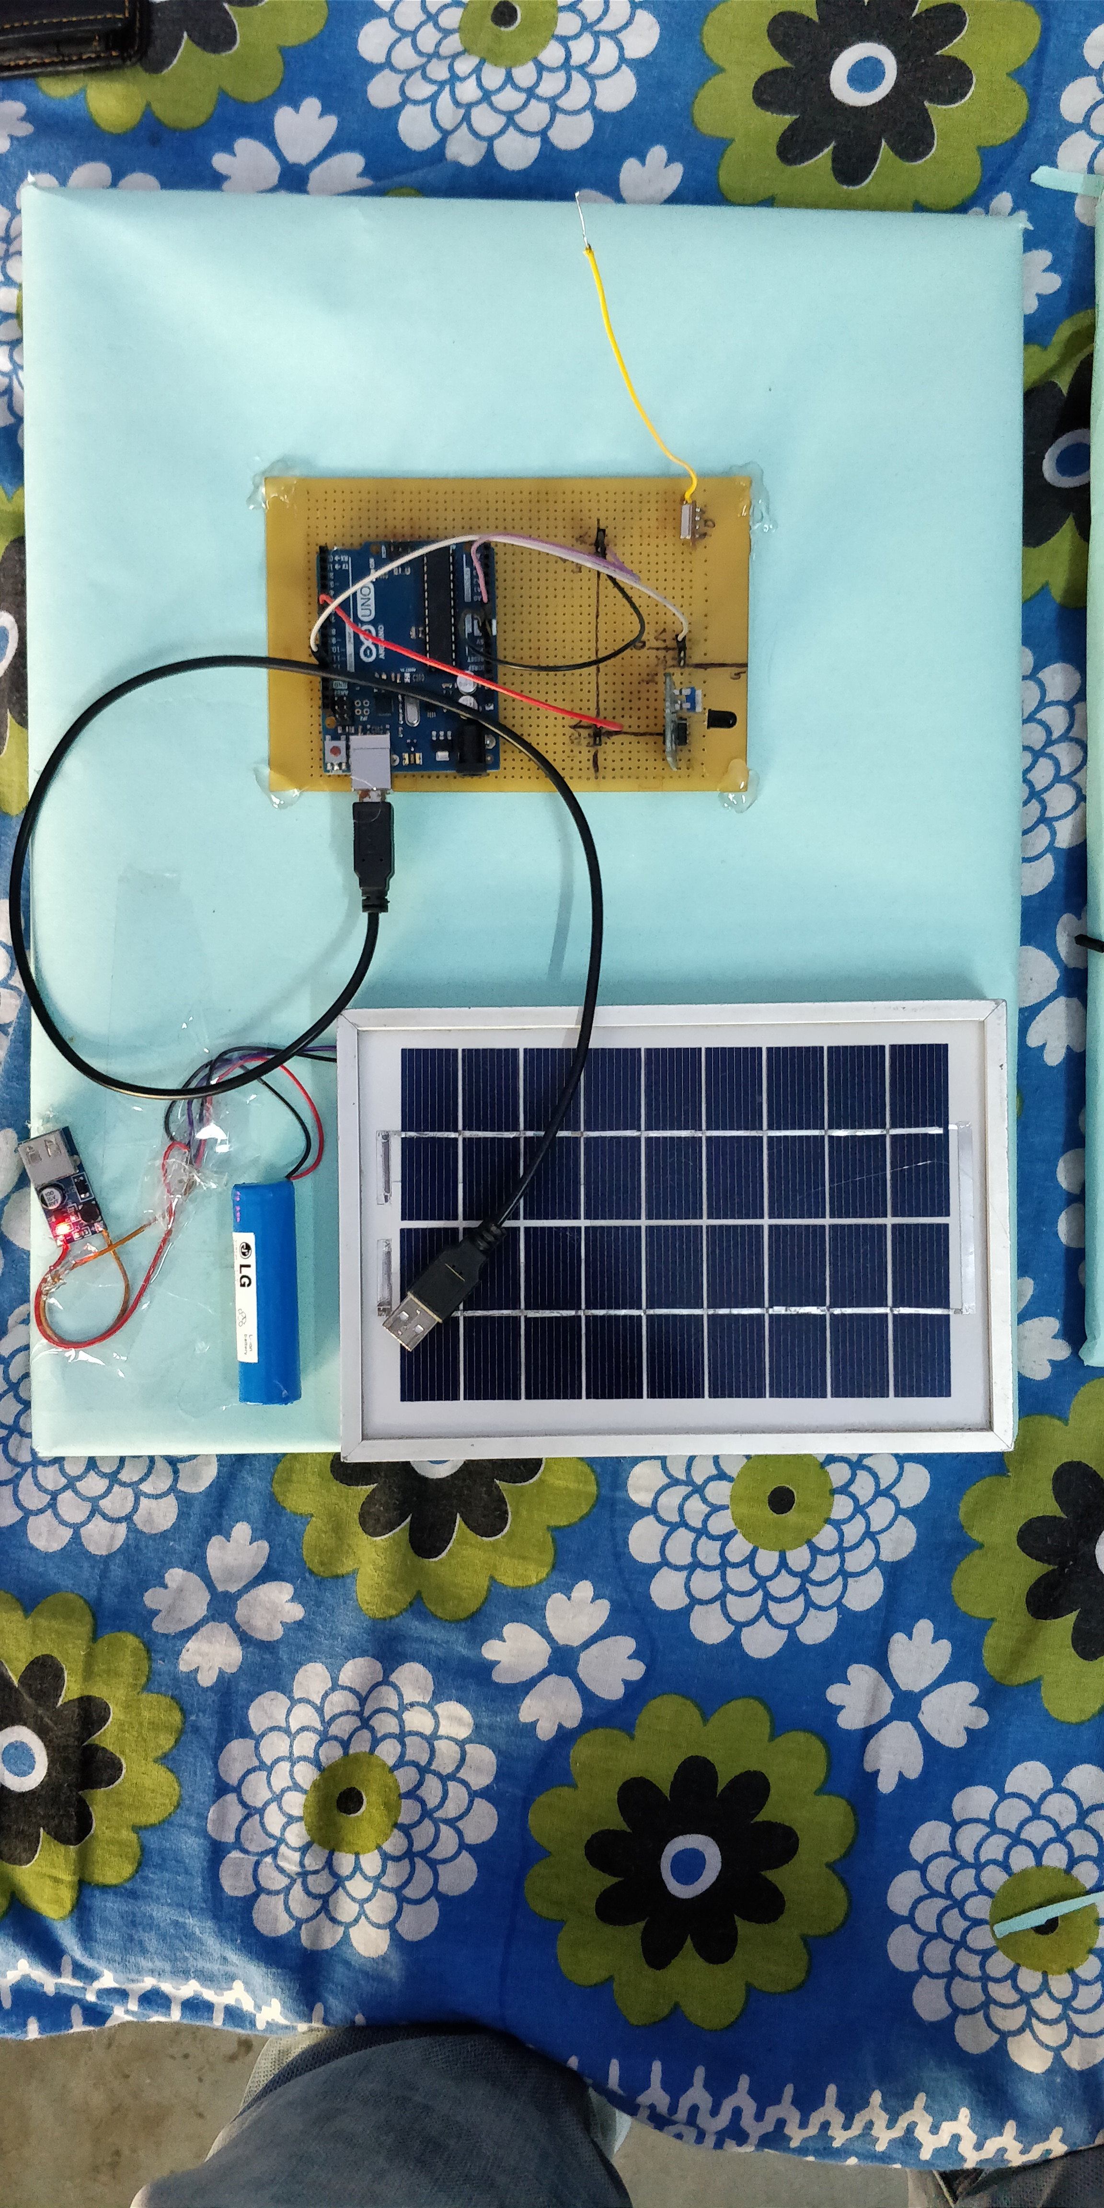
Transmitter and receiver

Slide 12
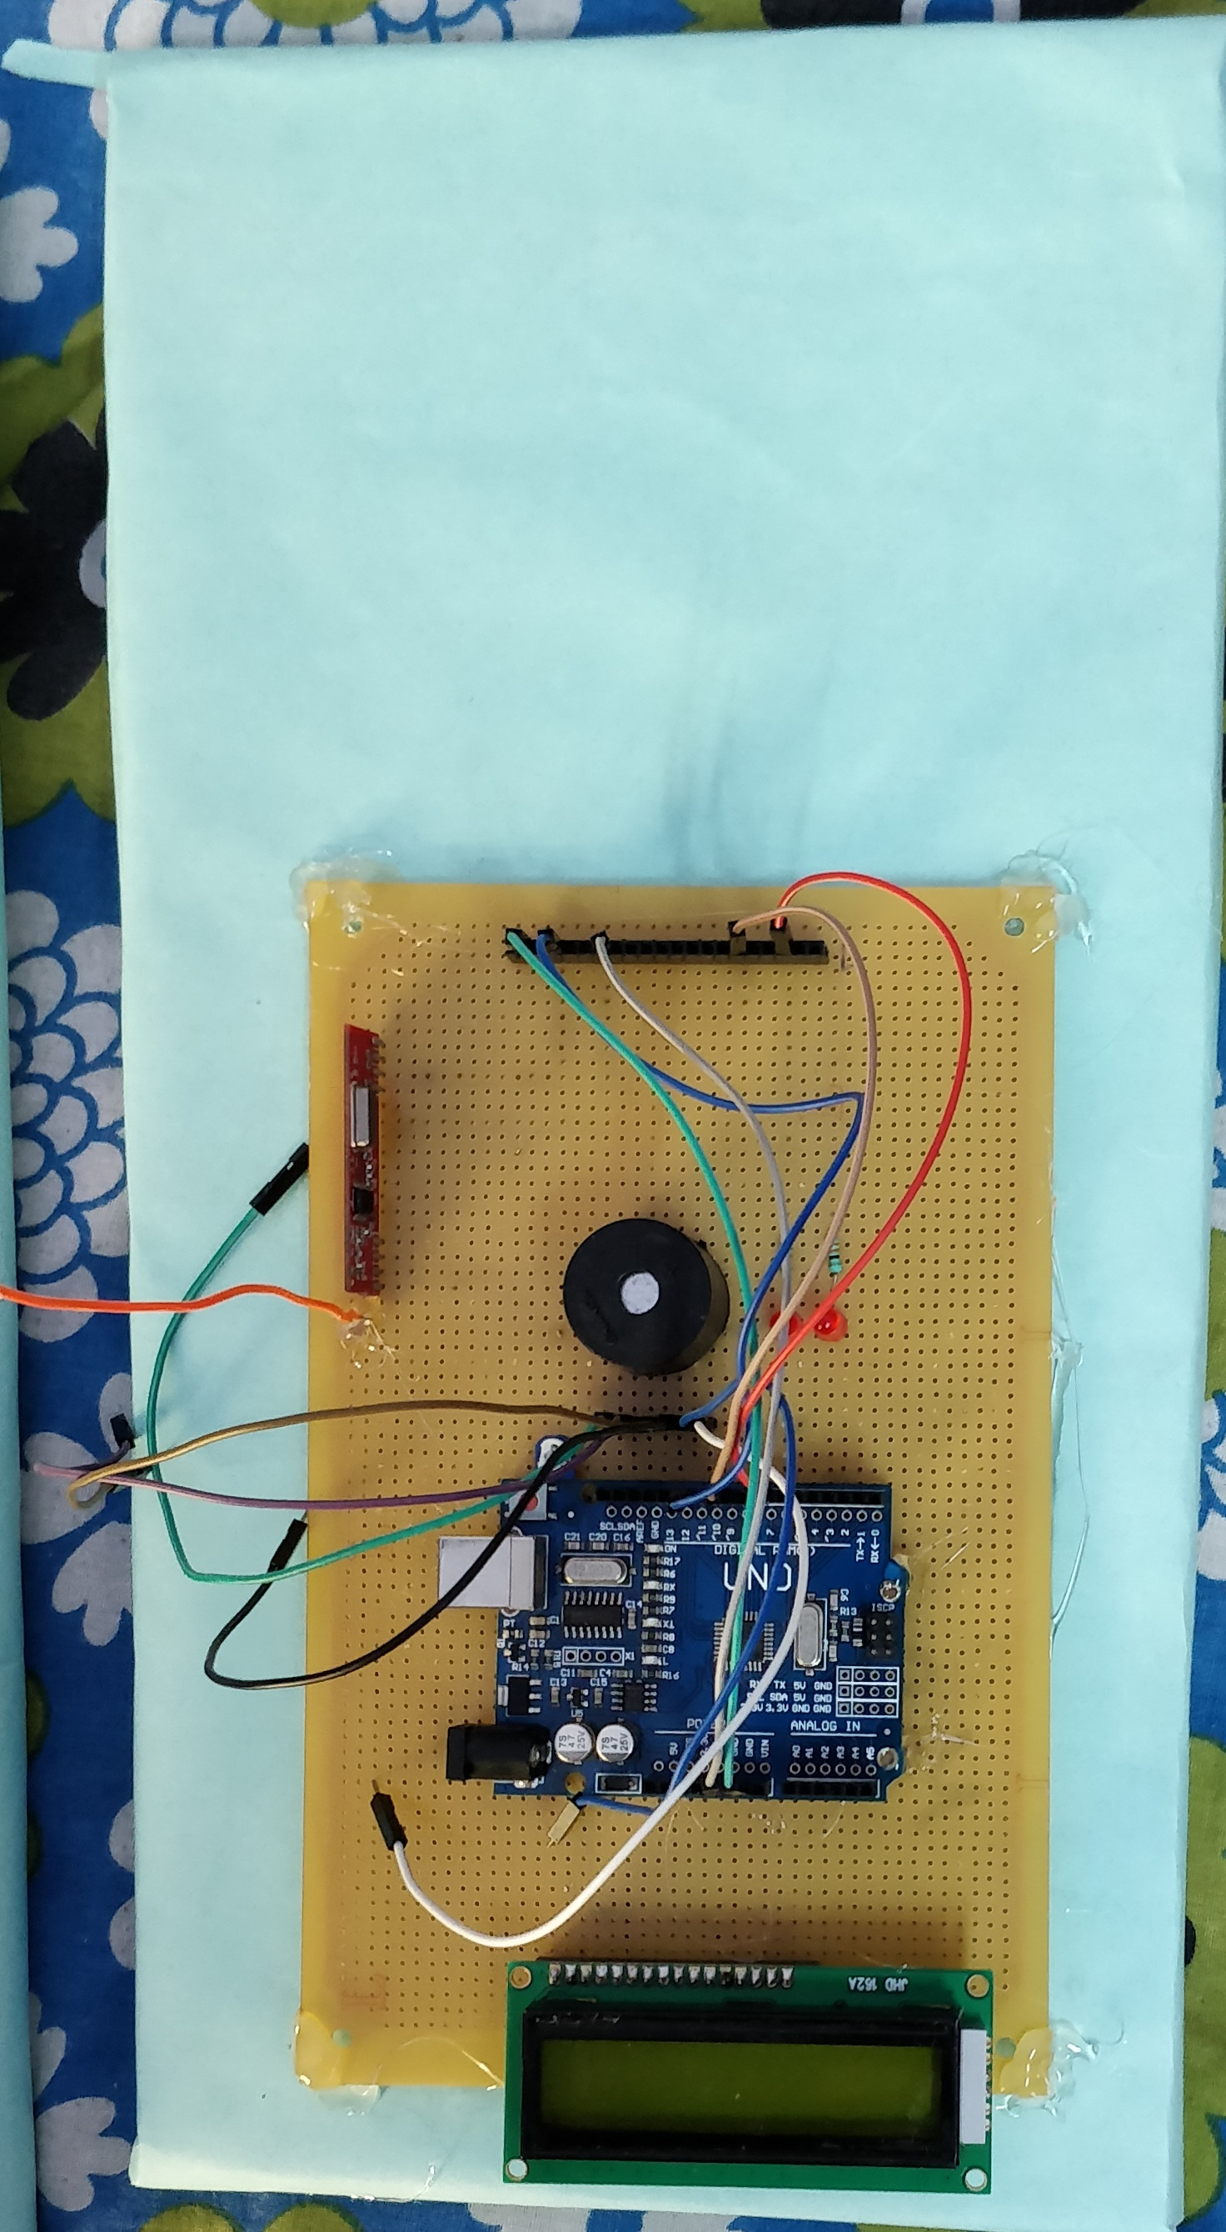
Reciever

Slide 13
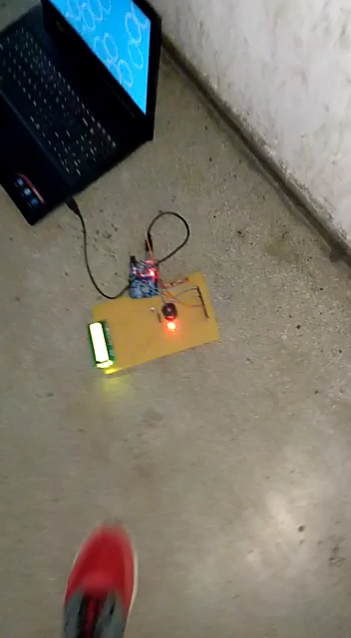
Video of the project

Slide 14
Thank you

